Slide 1
CS101-PROJECT
DdDISCRETE MATHEMATICS
“KNOT THEORY”
REPRESENTED BY:
HEMLATA GAUTAM - 2022CSB1084
RADHA - 2022CSB1108
SHAIKH ASRA - 2022CSB1121
SMRITI GUPTA - 2022CSB1128

Slide 2
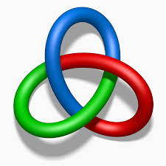
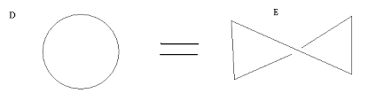
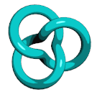
WHAT EXACTLY IS A KNOT?
"A Knot is a simple ,closed ,non-self-intersecting curve in R^3."​
KNOT THEORY , the study of closed curves in three dimensions , and their possible deformations without one part cutting through another. Knots may be regarded as formed by interlacing and looping a piece of string in any fashion and then joining the ends. ​
TREFOIL KNOT (3₁)
KNOT NOTATION ​
Minimum number of crossing points C(K) where k is ​the knot.
For example: In below fig: both figures are equivalent but ​C(D)= 0 and C(E)= 1.
C(D)= 0 C(E)= 1
As both D and E are equivalent but we will take C(D) as we have to take minimum.
In figure of trefoil knot, 3 depicts the minimum number of crossing points C(K).
And 1 in subscript is a knot index which is arbitrary.

Slide 3

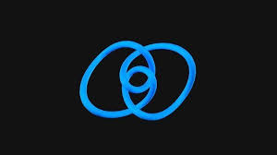
SOME STANDARD KNOTS
UNKNOT (0₁) TREFOIL KNOT(3₁) FIGURE EIGHT KNOT(4₁)

Slide 4
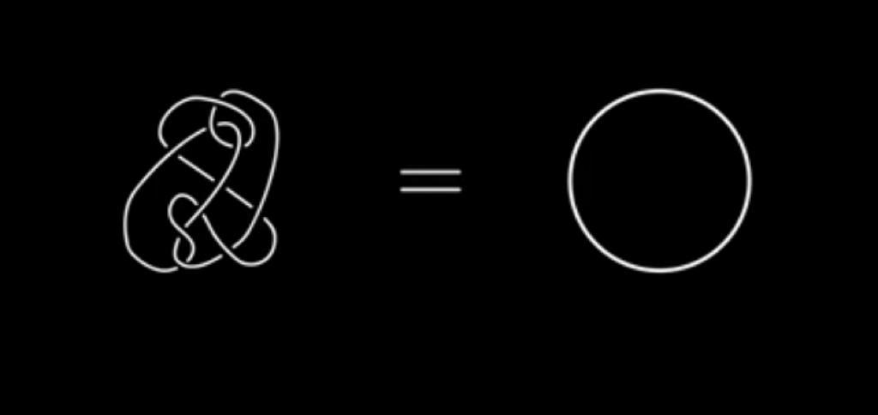
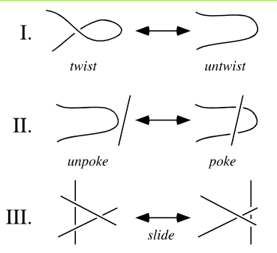
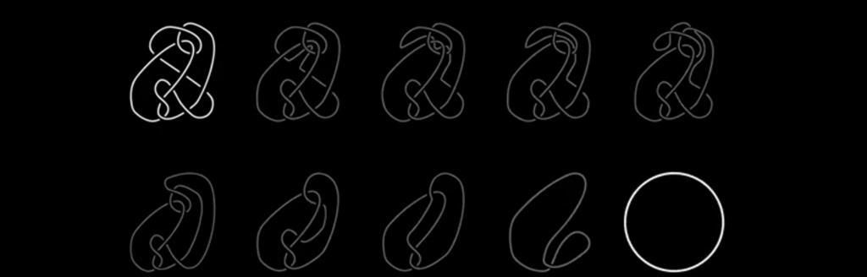
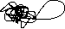
At first sight , me and my friends concluded that these shown below knots are not looking equivalent. MOST
PROBABLY your thinking would be same as us . BUT the intersecting fact is ,
we both are wrong ! Let's figure out how they are equal?
REIDEMEISTER MOVES
There are three simple allowed ways to deform knot diagrams by changing the number of crossings, and these three move are called Reidemeister moves.
We can deform a knot by using Reidemeister moves:
As u can see in the picture shown right to this it shows how Reidemeister moves can help in finding identical knots.

Slide 5
KNOT INVARIANTS
The knot characteristics which remain unaffected if one applies Reidemeister moves, are known as the knot invariants.
In order to differentiate two knots ,one should know about following knot invariants:-
THE MINIMUM NUMBER OF CROSSINGPOINTS
THE BRIDGE NUMBER:- It is the minimum possible number of intersection of strands of a knot.
THE UNKNOTTING NUMBER:-The number of times one must allow one strand of a knot to pass through another (in order to unknot it), is called the unknotting number.
THE LINKING NUMBER:-the linking number represents the number of times that each curve winds around the other.
THE COLOURING NUMBER OF A KNOT:- This invariants suggests that we can use different colours for distinguishing knots.
Out of the above knot invariants, we are going to discuss tricolorability in detail which is a part of colouring number of a knot.

Slide 6
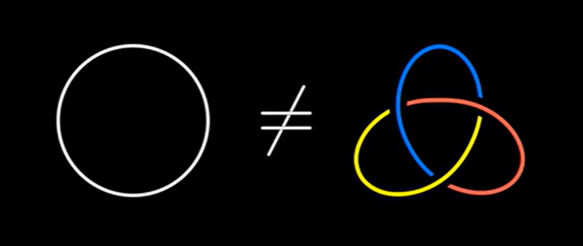
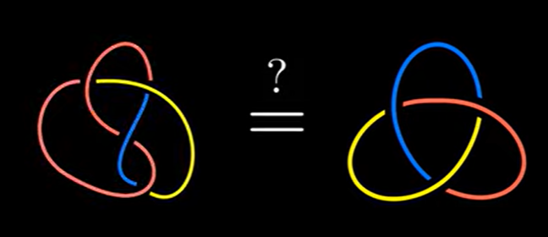
TRICOLORABILITY
The ability to colour a knot with three different colours, is known as tricolorability .This method is subjected to following two rules such that both of these rules must follow , if any one of them does not follow then the two knots are not equivalent and we can refer the knot (which is violating the rule) as a non tricolorable knot. The rules are:-
✯At least two different colours are used.
✯At each crossing, the incident strands are either :-
1. All of same colour
2. All of different colours
TREFOIL KNOT IS NOT AN UNKNOT
We will now prove that a trefoil knot is not an unknot ,i.e., an unknot is indeed different from trefoil knot.
An unknot can be coloured using only one colour which is violating the first rule whereas a trefoil knot can be coloured with three colours with each crossing having different colour simply implying that both of them are not equivalent.
Distinguish of a figure eight knot from trefoil knot….
As we can see the figure eight knot has one crossing such that the two out of three incident strands have same colour resulting in violation of the second rule. So, this suggests that the eight figure knot and the trefoil knot are different knots as the figure eight knot is non-tricolorable whereas trefoil knot is colorable.

Slide 7
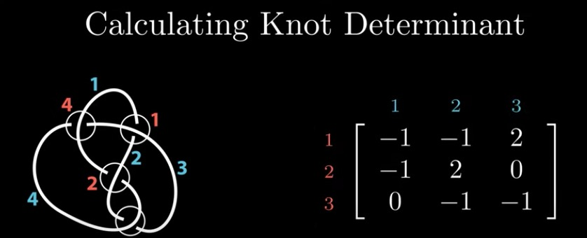
Now a new question arises that how to determine if two non tricolorable knots are different from each other?
To distinguish them, we have to understand one more knot invariant “ CALCULATING KNOT DETERMINANT”. This looks sort of interesting. Isn’t it?
CALCULATING KNOT DETERMINANT-
As the name suggests, we are going to number each crossing and component in order to find the knot determinant. Then draw an N x N matrix where N is the number of crossings.
In this matrix, the rows are referring to the crossing number and columns are referring to the components. Now, we have to put:-
✯ 2 in column corresponding to overcrossing component.
✯ -1 in columns corresponding to undercrossing components.
✯ 0 in columns corresponding to components not involved in any crossings.
After forming NxN matrix, delete a row and a column and find its determinant. The

Slide 8
WORKING OF ALEXANDER POLYNOMIAL
Start with a given knot or link and choose a particular projection of it. A projection is a way of representing the knot or link on a two-dimensional plane.
2) Orient the knot or link by choosing a direction for each crossing. This step is important because the Alexander
polynomial depends on the chosen orientation.
3) Assign variables to each crossing. For each crossing, assign a variable (e.g., t) and its inverse (e.g., 1/t). The variables are used to keep track of the crossings during the calculations.
4) Apply the skein relation. The skein relation is a formula that relates the Alexander polynomials of knots or links with different numbers of crossings. It allows you to simplify the polynomial by breaking down the knot or link into simpler components.
Repeat steps 1-4 until you reach the simplest possible knot or link, which is typically an unknot or the trivial link.
Once you have simplified the knot or link into its simplest form, you can read off the resulting polynomial as the Alexander polynomial.

Slide 9
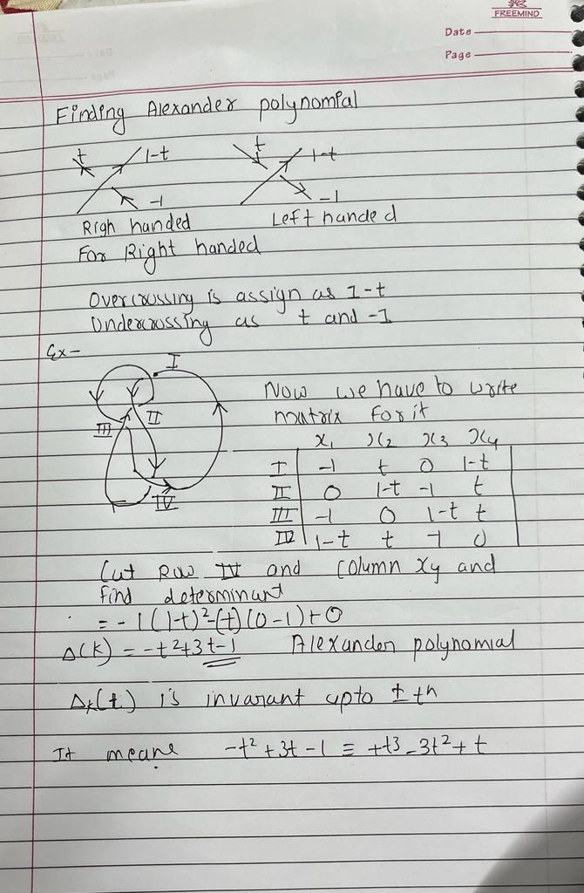
Alexander polynomial example

Slide 10
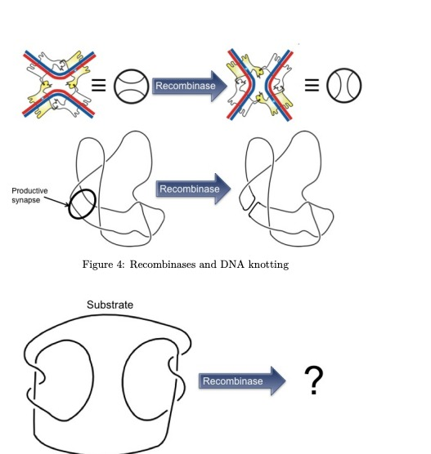
Understanding DNA recombination using KNOT THEORY
Introduction: DNA is the genetic material of all cells, containing coded information about cellular molecules and processes. DNA consists of two polynucleotide strands twisted around each other in a double helix. The first step in cellular division is to replicate DNA so that copies can be distributed to daughter cells. In order for replication or transcription to take place, DNA must first unpack itself so that it can interact with enzymes.
Question: How can knot theory help us understand DNA packing? How can we estimate the rates at which enzymes unknot DNA?
DNA can be seen as a complicated knot that must be unknotted by enzymes in order for replication or transcription to occur. It is perhaps not surprising then that connections between mathematical knot theory and biology have been discovered. By thinking of DNA as a knot, we can use knot theory to estimate how hard DNA is to unknot. This can help us estimate properties of the enzymes that unknot DNA.

Slide 11
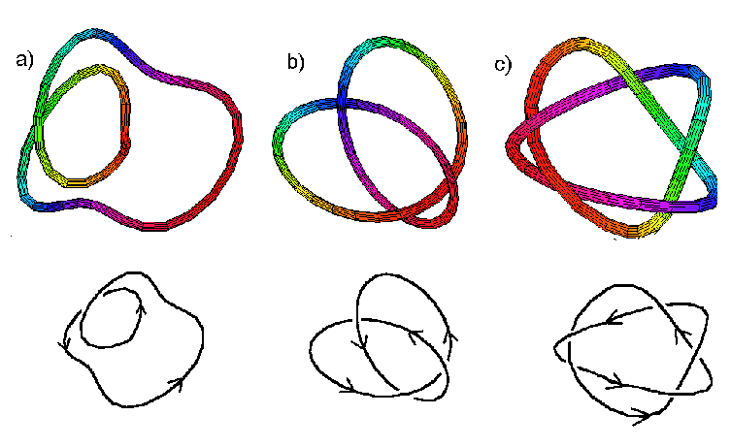
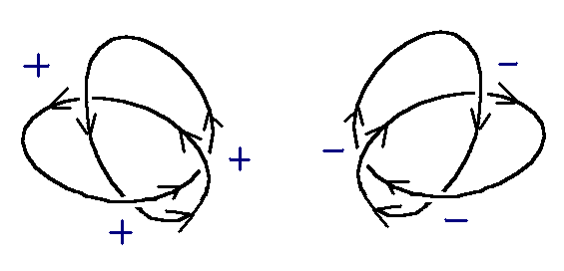
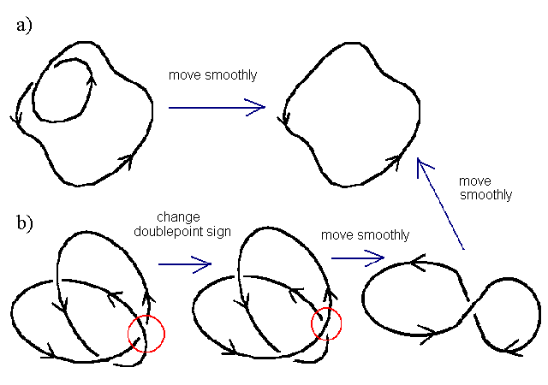
In figures 1 , The first knot is an "unknot" which is just twisted. It could be easily unknotted. The second knot is clearly a knot. The only way to get rid of the knot would be to cut it and simply tie it. The 3rd knot is more complicated.
In the fig 2: the arc will cross over or under itself. The crossing points are called double points. Each double point is denoted as + or - sign, depending on the orientation of the double points. If the arc that is passing over a double point can be turned clockwise less than 180 to align the direction of the arc underneath, then the sign is positive (+); if the arc on top must be rotated anti-clockwise, it is negative (-). The turns of a knot is the sum of all signs of its double points.
Figure 1
The only way to open a mathematical knot is to cut through the knot so that the arc that was on top is now underneath. This is equal to changing the sign of a double point . If a knot can be moved freely in 3D space to remove the double point , then that double point does not count toward the unknotting number. Consequently, in the figure below, knot a) has an unknotting number of zero, despite having one crossing point. Knot b) has an unknotting number of 1, despite having 3 crossing points.
Figure 2
A knot is in its ideal form if it has been moved smoothly through space so that all excess double points are removed. Knots are generally described by two numbers, C_{U}, the ideal crossing number (C) and the unknotting number (U). In the figure above, the knots would be 0₀ and 3₁, respectively. Mathematical knots may have values for writhe and crossing number that are much higher than the ideal number if they have been moved smoothly through space to a more complicated form.

Slide 12
CONCLUSION
CONCLUSION
Knot theory is a fascinating branch of mathematics that studies the properties and classifications of mathematical knots.
In our project, we discussed about the following concepts:-
✯Reidemeister moves:- They allow the manipulation and transformation of knots, researchers have been able to establish a foundation for understanding knot equivalence.
✯Knot invariants:- Knot invariants such as tricolorability polynomial, have played crucial roles in distinguishing different knot types and uncovering deeper structural characteristics.
✯The exploration of knots in DNA has provided valuable insights into the intricate and dynamic nature of genetic material. The interdisciplinary nature of knot theory highlights its significance in various fields, offering valuable contributions to both mathematics and biology.

